Slide 1
Types of interviews for Analytics / Data Science roles
Analytics Interviews
Technical
Behavioural
Skill assessment
Guess estimates
Case studies
Puzzles

Slide 2
Skills required in a data scientist
Analytical skills
Structured thinking & problem solving
Math, stats & Number crunching
Coding
Machine Learning
Soft skills
Communication
Curiosity
Influencing & managing stakeholders
People Perseverance
Domain Specific skills
Business Understanding
Process Knowledge

Slide 3
Life as a data scientist
Convert unstructured business problems to data problems
Generate Hypothesis
Collect, clean & transform data
Building models
Story-telling

Slide 4
Pros and cons of a data science career
Pros:
Good career progression
Remuneration
Sector expected to grow
Provides opportunities to shine, if you are good (experience does not matter as much)
Cons:
It is a knowledge treadmill
The companies which can benefit the most are the least reluctant to change

Slide 5
But let’s face it, making a mid-career transition isn’t easy
High opportunity costs
Responsibilities towards family
You would have never coded or might be out of touch with coding
Making a mid-career transition is like starting up on your own – you are excited about the idea, but giving that shape can be treacherous.

Slide 6
Be prepared for a gruelling 3 – 4 years period
Developing structured thought process is not an easy task – and there are limited number of good resources to help
To make things difficult, most of the openings are only for people with experience – only a few companies take and train freshers

Slide 7
The period can be a bit shorter for parallel tracks
A person selling IT solutions can transition into selling Big data solutions quickly
Similarly, a consultant with client facing experience can quickly move into a similar role

Slide 8
In spite of these challenges, there has been no better time to transition
Democratization of analytics tools
R / SAS / Weka / Python / Julia
QlikView / Tableau
Increase in analytics programmes and training courses
No programmes existed in India before 2010
Upgrad
The shortage of resources is forcing companies to try out new things
Hiring freshers
Global expos
I and Amazon can use the same cloud!

Slide 9
So, here is my advice to make an effective transition
This course or any coursework in India can not solve your employability by itself:
Develop structured thinking and communication skills
Learn extensively
Utilize free resources
Focus on practical learning
Learn by applying, especially statistics
Participate in Hackathons & competitions
Machine Learning, Structured thinking, skill tests
Start by learning one language and become good at it
SAS typically
R for people aiming to take up a job in startups
The best way to learn data science is to do data science

Slide 10
Other questions
Would my work experience be considered by prospective employer?
Non-technical experience – None
Technical non-analytical experience – Some benefit
Consulting / Research experience might count more
How much time can a transition take?
Any where between 0 – 24 months

Slide 11
Final takeaway – can I transition into analytics roles?
Clare had no background in data science. He had been in IT solutioning for last 8 years
Had deep passion to learn and apply data science
Learnt R, Python and SAS in a single year – but one at a time
With in 3 months of completing course on Business Analytics, got hired by an IT company (2k+ employees) to start their data science practice
Leads a team of 10 analysts and Ph.Ds today and plans to start a freelancing career shortly

Slide 12

Solving Guess-estimates

Slide 13
Solving Guess-estimates
It is the approach that matters – not the exact numbers
However, you should cross-validate numbers once you have them.
Always, I repeat always go top down.
Draw neat segmentation & diagrams
Keep a few common starting points / proxies on your finger tips
Population of your country, across the globe, GDP of your country
Analyze all possible uses of the subject
E.g. Tennis ball; B2B & B2C markets
Call out assumptions and possible blind spots

Slide 14
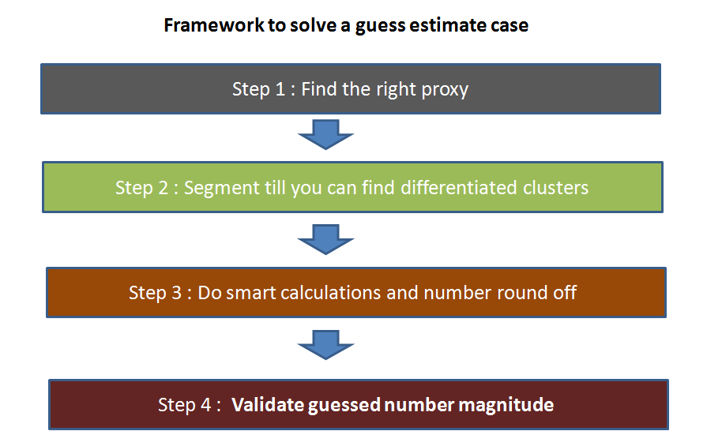
Framework to solve guess estimates

Slide 15
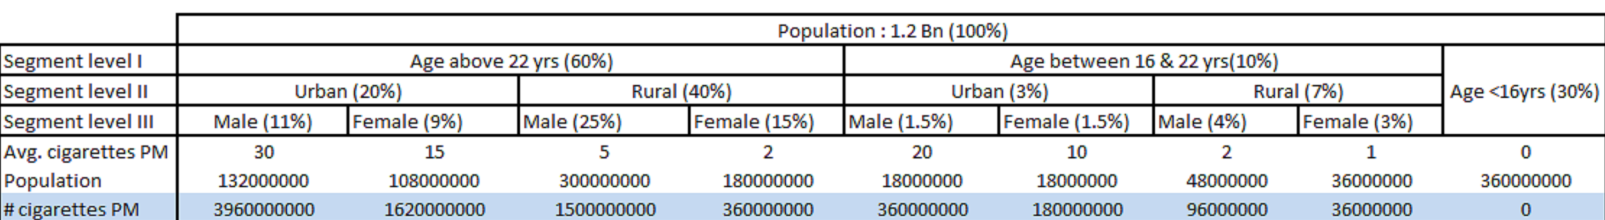
Guess-estimate example
Estimate number of cigarettes consumed in India

Slide 16
Guess estimate example - Assumptions / Considerations
The rural population consumes far lesser cigarettes than urban because of the purchasing power difference.
Male consume more cigarettes than female in both urban and rural populations.
Children below 16 years consume a negligible number of cigarettes.
Male to Female ratio in Urban is closer to 1 than that of Rural.
Male to Female ratio in younger generations is closer to 1 than that of older. This is because of the increase in awareness level.
Bulk of population start smoking after getting into a job and hence the average number cigarettes are higher in older groups.

Slide 17
A few other practice questions
Number of tennis balls used in India
Catch – Usage of tennis balls
Number of tablet used in India
Catch – B2B market (airlines, educational institutes etc.)

Slide 18
A few other examples to practice
Number of aircrafts in the air at this moment in time
Proxy – Airlines / Airports
Segment – Commercial + Cargo + Defense
Number of emails being sent across the globe at this moment in time
Proxy – Population
Segment – Professional + Personal + Spam
Amount of toll collected at Gurgaon toll at NH8
Proxy – Traffic pattern – Waiting time
Segment – Commercial and Personal
Market size for Pink Skateboards in France
Traffic between Bangalore and Chennai?

Slide 19
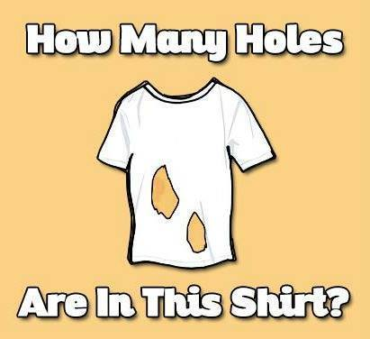
Puzzles

Slide 20
Frankly, puzzles are an unfair way to judge a candidate
You can know them before hand
At times, you just get it – without having a framework essentially
Don’t necessarily correlate with real life scenario
This also turns out to be an advantage for people who solve them

Slide 21
Puzzle 1
Two trains X and Y (80 km from each other) are running towards each other on the same track with a speed of 40km/hr. A bird starts from the train X and travels towards train Y with constant speed of 100km/hr. Once it reaches train Y, it turns and starts moving toward train X. It does this till the two trains collides with each other. Find the total distance travelled by the bird?
Time to solve – 1 minute
Answer – 100 kms

Slide 22
Puzzle 2
You have two beakers – one of 4 ltr and other of 5 ltr. You are expected to pour exactly 7 ltr in a bucket. How will you complete the task?
Time to solve – 2 minute
Answer – 100 kms

Slide 23
Puzzle 3
There are 5 pirates in a ship. Pirates have hierarchy C1, C2, C3, C4 and C5.C1 designation is the highest and C5 is the lowest. These pirates have three characteristics : a. Every pirate is so greedy that he can even take lives to make more money. b. Every pirate desperately wants to stay alive. c. They are all very intelligent.
There are total 100 gold coins on the ship. The person with the highest designation on the deck is expected to make the distribution. If the majority on the deck does not agree to the distribution proposed, the highest designation pirate will be thrown out of the ship (or simply killed). Only the person with the highest designation can be killed at any moment. What is the right distribution of the coins proposed by the captain so that he is not killed and does make maximum amount?
Time to solve – 15 minute

Slide 24
Puzzle 3
Solution : The solution of this problem lies in thinking through what will happen if all the pirates were thrown one by one and then thinking in reverse order.
Let us name pirates as A,B,C,D and E in hierarchy (A being highest).
If only D and E are left at end, D will simply give 0 coins to E and still escape because majority cannot be reached. Hence, even if E gets 1 coin he will give his vote to the distributor.
If C, D and E are there on the deck, C will simply give one coin to E to get his vote. And D simply gets nothing. Hence, even if D gets 1 coin he will give his vote to the distributor.
If B,C,D and E are there on the deck, B will simply give one coin to D to get his vote. C & E simply gets nothing.
If A,B,C,D and E are there on the deck, A simply gives 1 coin each to C and E to get their votes.
Hence, in the final solution A gets 98 coins and only C & E get 1 coin each.

Slide 25


Room 1
Room 2

Slide 26


Slide 27
Additional puzzles to practice
Find the defective coin stack:
You have 10 stacks of 10 coins each. Each coin weights 10 gms. However, one stack of coins is defective and each coin in that stack weights only 9 gms.
What is the minimum number of weights you need to take to find which stack is defective? How?

Slide 28
Additional puzzles to practice
Find the fastest horses:
There are 25 horses. We have to find out the fastest 3 horses. In one race maximum 5 horses can run. How many such races are required in minimum to get the result?
Lie Tribe and Truth Tribe:
There are two tribes in Mars, Lie tribe and Truth Tribe. Lie tribe always speaks lie, True tribe always speaks truth. You meet three mars people and ask
From First Person: What tribe you belong to?, he replies something in his language which you don’t understand.
Second person tells that he is saying that he belongs to Lie Tribe.
Third person says that second person is lying.
What tribe does the third person belong to?

Slide 29
Additional puzzles to practice
You have 20 blue balls and 14 red balls in a bag. You put your hand in and remove 2 at a time. If they’re of the same color, you add a blue ball to the bag. If they’re of different colors, you add a red ball to the bag. (assume you have a big supply of blue & red balls for this purpose. note: when you take the two balls out, you don’t put them back in, so the number of balls in the bag keeps decreasing). What will be the color of the last ball left in the bag?

Slide 30
Case studies

Slide 31

Solving case studies
Case interviews are broad, two-way discussions rather than one-way tests. You will be assessed more on how you go about dealing with the problem rather than on the specific answers you come up with.

Slide 32
Case studies - A few things to remember
Structure, structure and structure!
Focus on frameworks
Call out assumptions
Think out loud – it is the thinking process, which matters
Lay out things neatly on paper

Slide 33
Flow of a typical case study
Start with a general question – test candidate on white space thinking
Provide specific numbers and ask for calculations / suggestions
Tweaks in problems to make it more interesting

Slide 34
Case study - example
Scenario:
You have just joined a new bank as a campaign manager. In this role, you will be responsible for sending out campaigns to potential customers.
Your manager tells you that there is a meeting in an hour, where you will need to decide, which service provider to choose for next campaign.
What factors would you consider?

Slide 35
Answers to avoid
Anything out of hat:
We will look at delivery rate and decide; (or)
We will go ahead with vendor, where we have better relationship
Instead lay out a framework and then explain factors:
ROI = Return / Cost = (Number of mails x Delivery rate x response rate x value) / (Number of mails x cost per mail)
Then layout the factors:
Capacity to deliver, cost to deliver, quality of delivery, brand awareness

Slide 36
Case study - example
Your new campaign is going to go out in a week time. You need to mail high quality marketing material to an identified set of customers. There are 2 options to send out this material:
Which option would you go with?
Service | Delivery rate | Cost (INR) / mail sent | Response rate | Life time value of a customer
A | 70% | 5 | 1% | 2000
B | 90% | 8 | 1.5% | 2000

Slide 37
Case study - example
Equation:
Return on campaign = Life time value of customer / Cost
= (1000 x 70% x 1% x 2000 / 1000 x 5) = 2.8 (for service A)
= (1000 x 90% x 1.5% x 2000 / 1000 x 8) = 3.375 (for service B)
Service | Delivery rate | Cost (INR) / mail sent | Response rate | Life time value of a customer
A | 70% | 5 | 1% | 2000
B | 90% | 8 | 1.5% | 2000

Slide 38
Case study - example
Possible re-evaluations
Post feedback from you, service A reviewed its service and is now ensuring a minimum delivery to 85% people – would you still stay with current partner?
Return on A now becomes: (1000 x 85% x 1% x 2000 / 1000 x 5) = 3.4
Possible shortcut = 2.8 x (85% / 70%)
Another smart solution – Given that the return is now very similar, we should look at other factors like compliance, quality of delivery, professionalism

Slide 39
Case study - example
Another complexity
Upon discussions with Service B, you realize that they only deliver in Metro and Tier 1 cities does not deliver to rural areas. For like to like comparison – their delivery rates are 95%. Which one would you now prefer?

Slide 40
Case study - summary
Will typically start from a broad question and would narrow down
Look out for cues from your interviewer
Keep a broad approach until and unless asked to narrow down
Structure, structure and structure!
Work in a manner that can be re-used later on

Slide 41
Few additional case studies available on the internet to practice
http://www.slideshare.net/Shelly38/case-interview-these-interviews-will-give-you-an-opportunity

Slide 42

Things to avoid in an analytics interview

Slide 43
Things to avoid in an analytics interview
Hygiene factors:
Reaching late
Messed up document folder - When someone asks you for the CV, it takes you more than 10 seconds to pull it out.
Not writing your case study solution in a structured fashion.
Common mistake
Keep re-usability in mind
If it is a coding assignment, not indenting and commenting your code. Same principle as the last point. It also shows, how much of your work would be re-usable by others.
If you have done something wrong, defending it rather than accepting it and correcting it.
Error / typo in a CV or a non-updated CV

Slide 44
Things to avoid in an analytics interview
Numerical abilities:
Using calculators / excel too often
Not taking shortcuts when they are available
Not triangulating numbers once they have been calculated.
Curiosity / Motivation:
Not asking enough good questions during the interview rounds or outside.
Not asking for clarity in an ambiguous / amorphous situation
Lack of energy at any point in time during the process.
Discomfort in doing white board discussions during the interview.

Slide 45
Things to avoid in an analytics interview
Problem solving:
Not suggesting unconventional solutions
Suggesting too complex solutions to simple business problems
Thinking about the problem on a single track (usually data driven solutions) rather than holistically (e.g. Marketing, Operations, etc.)

Slide 46
What should you expect through this workshop?
Understand what is an analytics interview?
How is it different from other interviews you may have faced?
What is the employer trying to evaluate you on?
How to prepare for analytics interview?
Case study and resources

Slide 47
Questions?

